Slide 1
Backpropagation
Prakash P VIT , Chennai

Slide 2
Road Map
Feed forward network
Backpropagation
Backpropagation Example

Slide 3
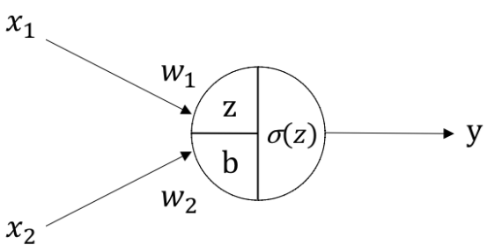
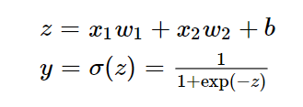
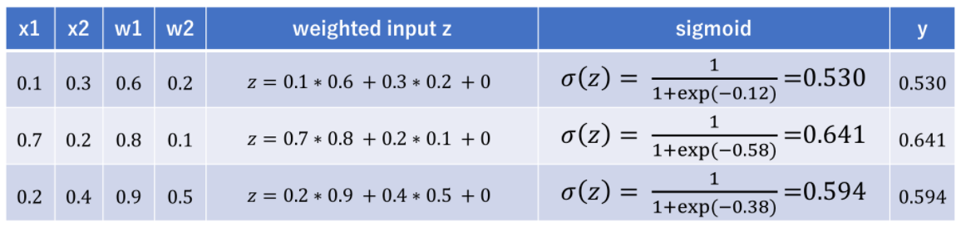
Example of Feed Forward Neural Network
z is the weighted input
b is bias
y is the output
σ(z) is the activation function which represents sigmoid function
x1, x2 are the inputs. w1, w2 are the coefficient weights for each input

Slide 4
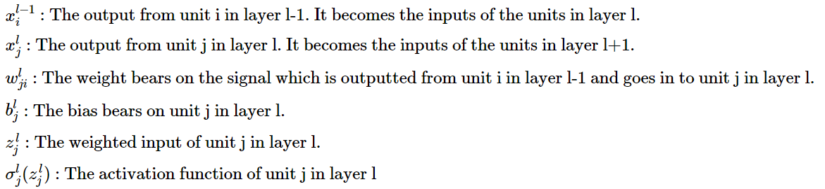
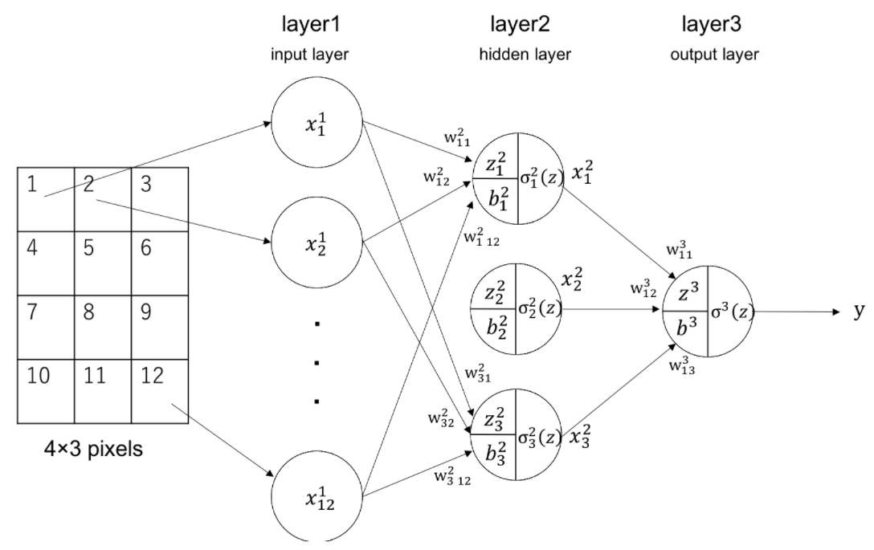
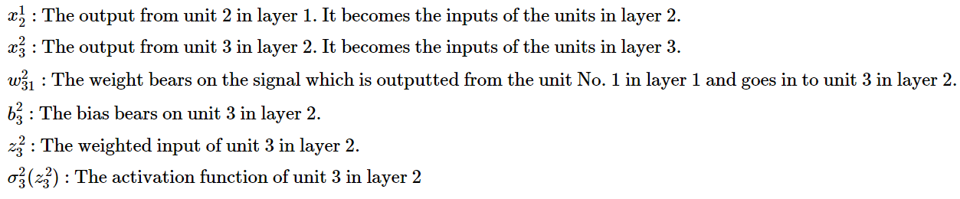
Variables and Parameters
Neural network classifying 4×3 pixel picture

Slide 5
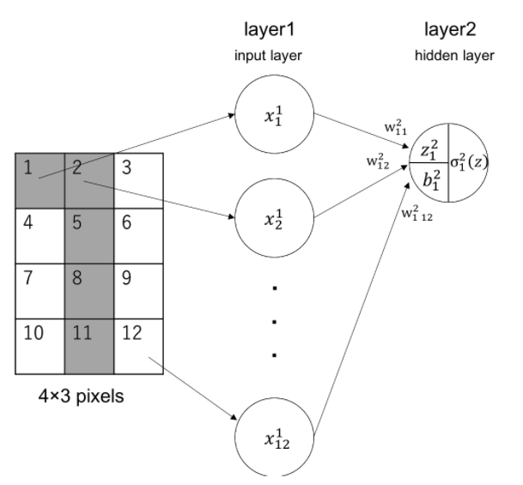
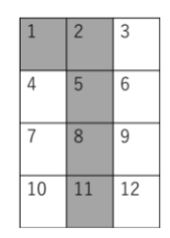
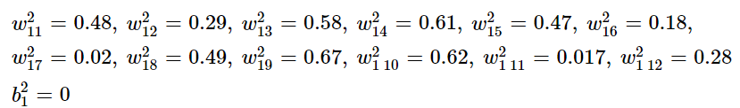
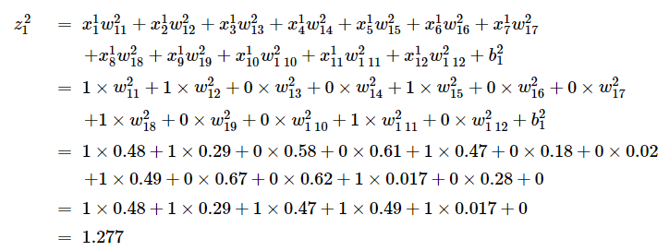
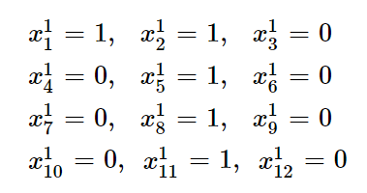
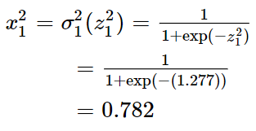
Binary Classification of a Picture Using 1 Unit
let’s say we put the following picture as input
the weights are set as random (0 to 1 value) and the bias is set as 0
the inputs of the input layer, that is, the inputs of the hidden layer would be as follows

Slide 6
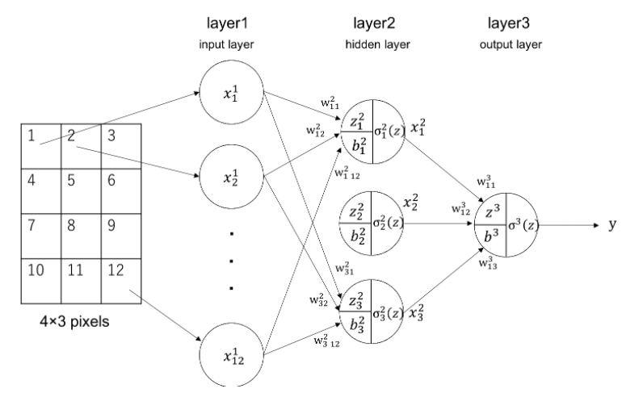
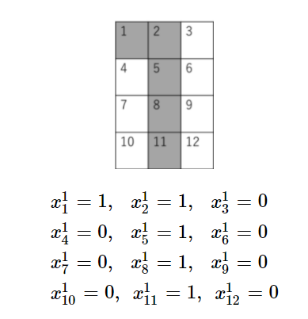
Binary Classification of a Picture Using 1 Unit
calculate using all of the units of the neural network, and calculate the final output of the whole network

Slide 7
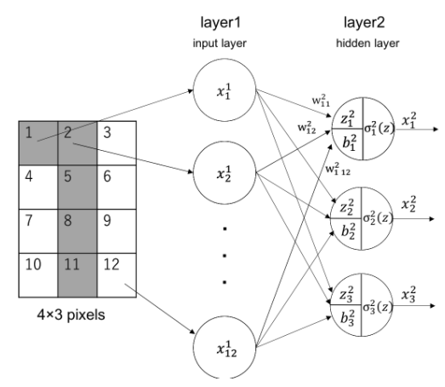
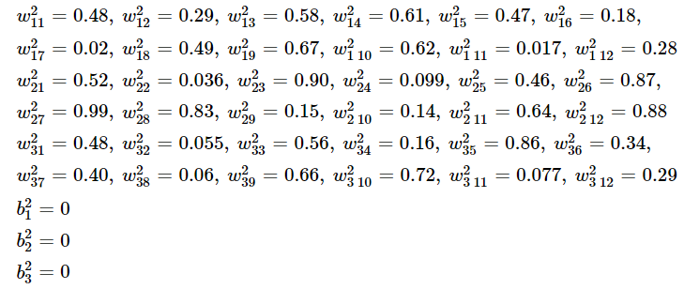
Binary Classification of a Picture Using 1 Unit
calculate using all of the units of the neural network, and calculate the final output of the whole network
initialize the weights with random values (0~1) and the bias as 0

Slide 8
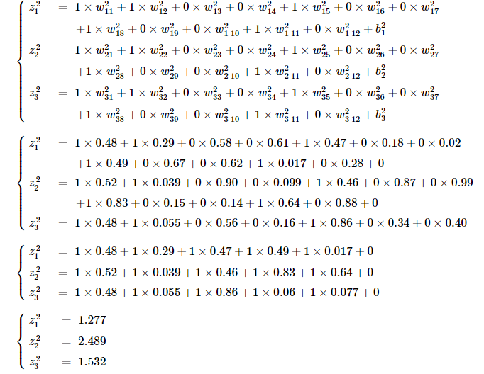
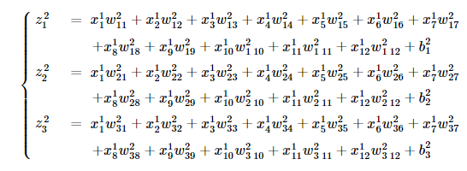
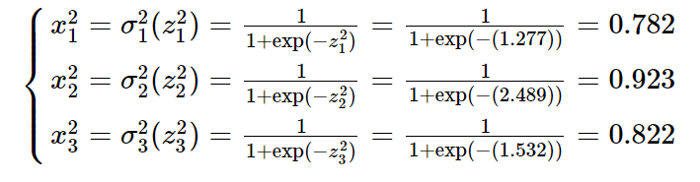
Binary Classification of a Picture Using 1 Unit
calculate using all of the units of the neural network, and calculate the final output of the whole network
Input layer → Hidden layer

Slide 9
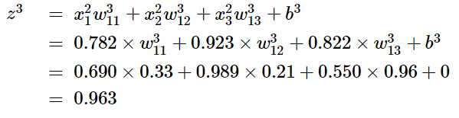
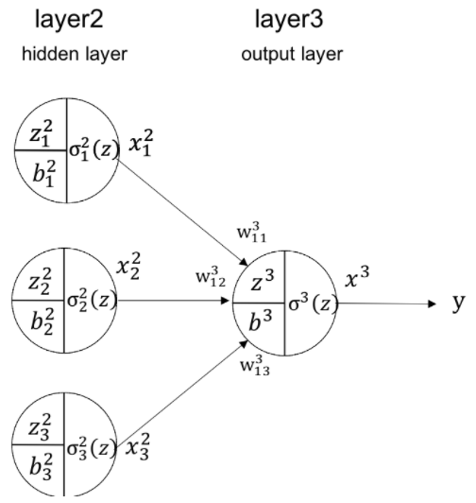

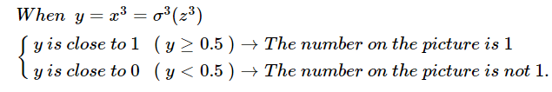
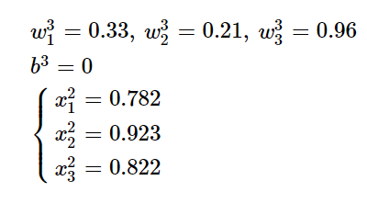
Binary Classification of a Picture Using 1 Unit
calculate using all of the units of the neural network, and calculate the final output of the whole network
Hidden layer → Output layer
In the other words, the parameters were aimlessly set up in the first place and happen to give an accurate result. When learning with neural network, the neural network adjust its own parameters to give a better accurate classification result. To do this, an algorithm called "Backpropagation" is used to calculate how much update is needed for each weight
It is y≥0.5 , thus y is close to 1. This means The number on the picture is 1.

Slide 10
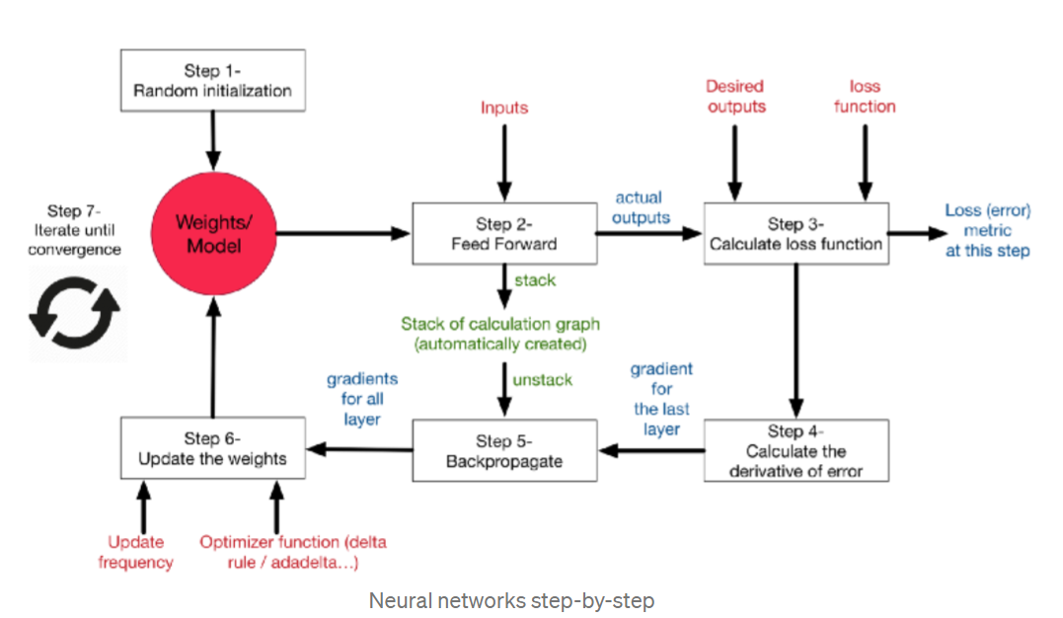
Overall picture

Slide 11
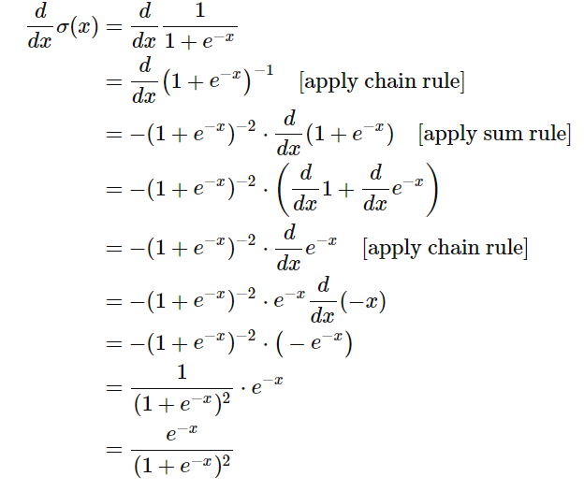
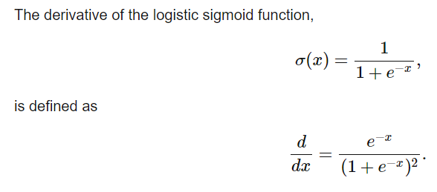
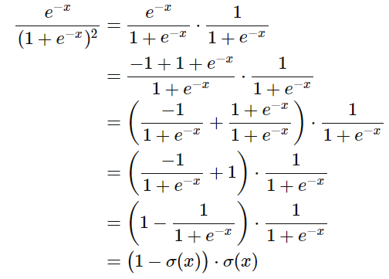
What is the derivative of the logistic sigmoid function?

Slide 12
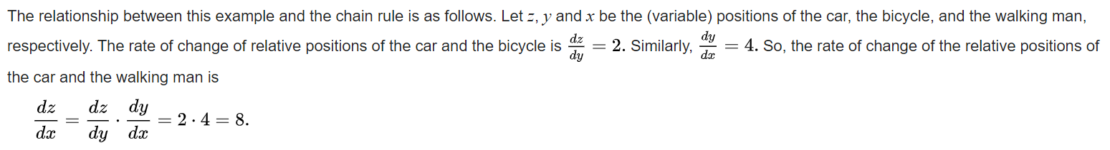
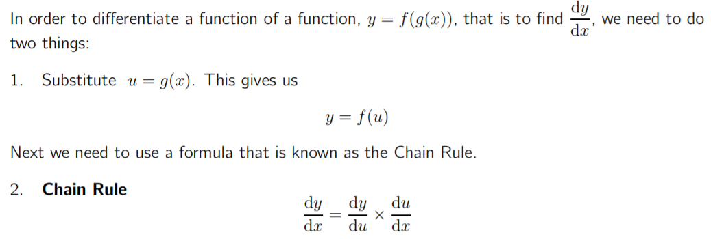
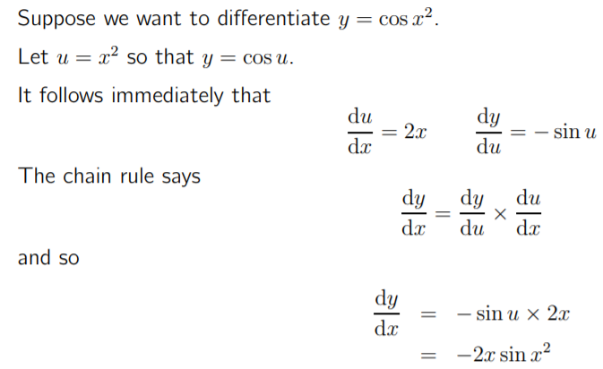
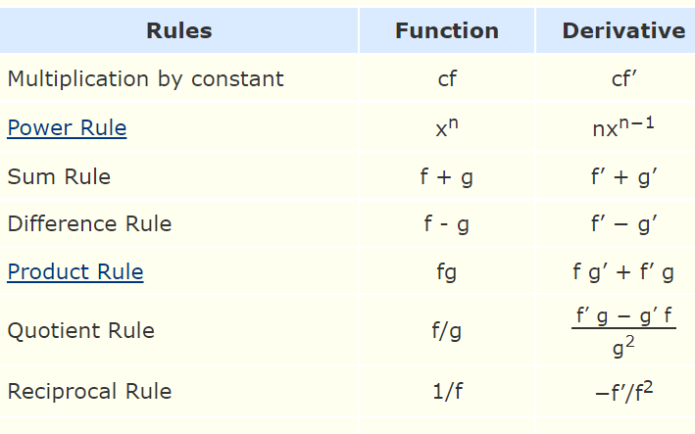
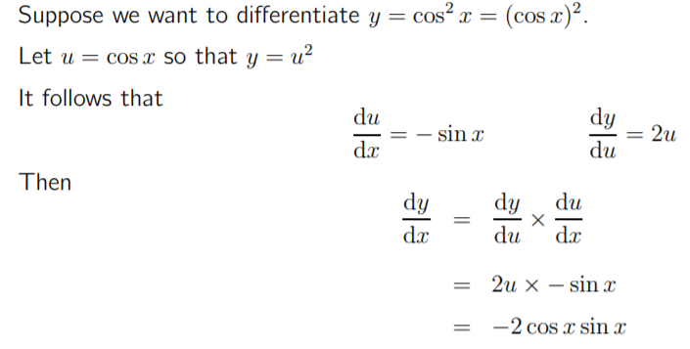
Chain rule
As put by George F. Simmons: "if a car travels twice as fast as a bicycle and the bicycle is four times as fast as a walking man, then the car travels 2 × 4 = 8 times as fast as the man.

Slide 13
References
https://www.renom.jp/notebooks/tutorial/beginners_guide/feedforward_example_1/notebook.html
https://datascience.eu/artificial-intelligence/how-the-backpropagation-algorithm-works/
https://www.youtube.com/watch?v=jc2IthslyzM

Slide 14
Thanks

